Slide 1

Notes to Instructor
Material Needed
Hard copies of the following:
ADaM Model Document v2.1
ADaM IG v1.1
ADaM Data Structure for Occurrence Data v1.0
ADaM Basic Data Structure for Time to Event v1.0
FDA Study Data Technical Conformance Guide
with labelled Post-It notes attached to the first page of each document
Each participant will need to bring their laptop to access workshop templates needed to complete workshop exercises
Excel file Exercise Templates and additional electronic resources on the External SharePoint site

Slide 2
Electronic Documents Required
ADaM Workshop Module 6.pptx (this power point)
Participants will need the following for exercises:
Lilly ADaM Mod 6 Exercise.xlsx
Core_ADAM_ADAE_V8.xlsx
Core_ADaM_ADMH_V7.xlsx
Core_ADAM_ADCM_V9.xlsx
For Reference:
ADaM Model Document v2.1
ADaM IG v1.1
ADaM Data Structure for Occurrence Data v1.0
ADaM Basic Data Structure for Time to Event v1.0
FDA Study Data Technical Conformance Guide
ADaM_OTHER_Metadata_Template_v3.xlsx
Core_TFL_AE_PT_SOC_V1.xlsx

Slide 3
Lilly Workshop Module 6 Occurrence Data Structure, ADaM Other, and Intermediate Data Sets

Slide 4
Objectives
Encourage participation to enhance learning in this hands-on workshop
Recognize the features of the Occurrence Data Structure and know when to use it
Understand the value and flag variables that can be included in an Occurrence Data Set
Be aware when an ADaM OTHER Class may be used (rarely)!
Realize the benefit of intermediate datasets as a way to enhance traceability

Slide 5
The Occurrence Data Structure (OCCDS)

Slide 6
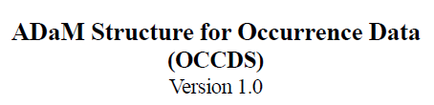
Occurrence Data Structure (OCCDS)
Recap (OCCDS is not ADSL nor BDS)
ADSL is characterized by one record per subject and required variables such as treatment, demographics
BDS is characterized by a Parameter which has values that are analyzed (AVAL and functions of AVAL)
OCCDS is the 3rd recognized ADaM data structure

Slide 7

When Should OCCDS Be Used?
To analyze the occurrence of events
There is no concept of AVAL
Much of the data content from SDTM can be used for analysis purposes
A dictionary (with or without hierarchy) may be used to code the occurrence
Notes:
AVAL explanation: For analysis of occurrences, we count events and each event is on a separate record

Slide 8

Variables in OCCDS
Open ADaM OCCDS v1.pdf
Review variables as a group (SDTM, ADSL, Derived?)
3.2.2 Identifier Variables
3.2.3 Dictionary Coding & Categorization Variable
3.2.4 Timing Variables
3.2.5 Indicator Variables
3.2.6 Occurrence Flag Variables
3.2.7 Treatment/Dose Variables
3.2.8 Descriptive Variables
3.2.9 Standardized MedDRA Query Variables
Notes:
Ask class to participate as you go over types of variables in OCCDS. Ask about the source of each type of variables (SDTM or ADaM)?

Slide 9
Most Frequent Use for OCCDS
Analysis of:
Adverse Events
Con Meds
Medical History
Clinical Events
Protocol Violations
In all cases, we analyze either the number and percent of subjects who had at least one event (incidence) and/or the total number of events

Slide 10

Flag Variables for OCCDS
ONTRTFL: flags records where event occurred between TRTSDT and TRTEDT
FUFL: flags records occurring after TRTEDT
PREFL: flags records occurring before TRTSDT
NOTE: even though these flags were defined in the OCCDS model, they can be used in any AD
Notes:
Also called Indicator Variables
Emphasis that they can be used in any AD but need to be used in analysis for inclusion, not convenience

Slide 11
OCCDS – Adverse Events (ADAE)

Slide 12

ADAE
The class of OCCDS came from the extension of an early ADaM model for ADAE
SDTM AE domain contains much of the information we need for analysis
Additional variables in the OCCDS model can be added that specifically relate to analysis of adverse events

Slide 13
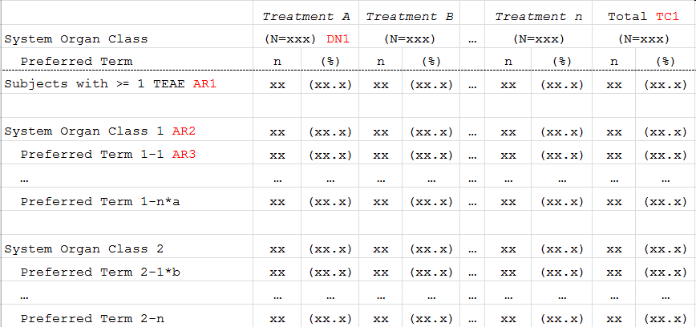
Lilly Core AE Table

Slide 14
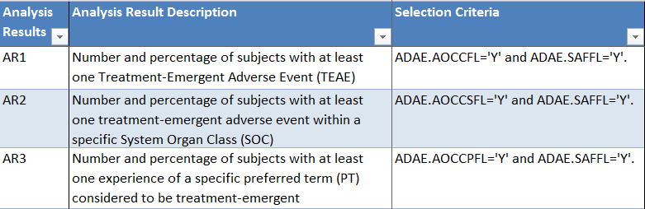
Lilly Analysis Results Metadata
Below is a subset of the Analysis Results Metadata for a Lilly Core AE Table
Notice the OCCDS “Selection Criteria” variables

Slide 15
Treatment Emergent Flag in ADAE
TRTEMFL: Treatment emergent flag – Y / null
This is one of the most important flags for ADAE
It indicates whether a given AE is summarized in the treatment emergent table summaries
Open Lilly Core_ADaM_ADAE_V8.xls to see the ANALYSIS_ALGORITHM for TRTEMFL
Lilly provides ‘robust’ Analysis_Algorithm for how to derived this flag
Pre-Treatment
Exposure to Treatment
Treatment-Emergent AE (TEAE)

Slide 16
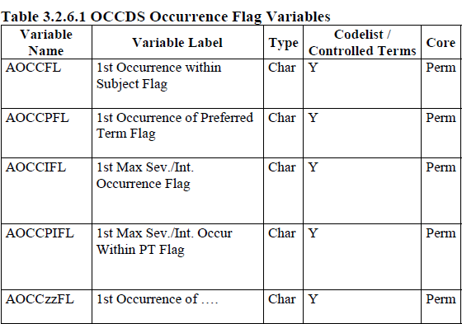
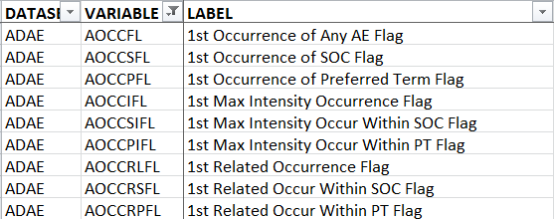
Occurrence Flag Variables ADAE
The ADaM model defines a multitude of occurrence flags
Lilly defines additional occurrence flags

Slide 17
Build ADAE – Start with SDTM
Structure generally reflects the structure of SDTM source domain
Most variables from SDTM are included without any change
AESEQ | AETERM | AEDECOD | AEBODSYS
1 | HEADACHE | Headache | Nervous System Disorder
2 | PROBLEMS OF HYPOTENSION | Hypotension | Vascular Disorder
AESEQ | AESTDTC | AEENDTC | AESER | AESEV
1 | 2006-02 | 2006-02-05 | N | MILD
2 | 2006-03-05 | 2006 | N | MODERATE

Slide 18
Build ADAE – Add ADSL Variables
Add subject level variables from ADSL as needed
AESEQ | AEDECOD | SAFFL | TRTA | TRTAN
1 | Headache | Y | Drug A | 1
2 | Hypotension | N | Placebo | 2
AESEQ | TRTSDT | TRTEDT | AGE | AGEGR1 | SEX | RACE
1 | 23JAN2006 | 15MAY2006 | 54 | <65 | M | ASIAN
2 | 23JAN2006 | 15MAY2006 | 54 | <65 | M | ASIAN

Slide 19
Build ADAE – Add Derived Variables
Add additional derived analysis variables as needed
Flags
APERIOD, APHASE
Numeric versions of dates
AESEQ | AEDECOD | ASTDTC | ASTDT | ASTDTF | AENDTC | AENDT
1 | Headache | FEB2006 | 01FEB2006 | D | 05FEB2006 | 05FEB2006
2 | Hypotension | 05MAR2006 | 05MAR2006 |  | 2006 | 15JUL2006
AESEQ | AENDTF | APERIODC | TRTEMFL | AOCCFL | AOCCSFL | AOCCPFL
1 |  | DB TRT | Y | Y | Y | Y
2 | M | DB TRT | Y |  | Y | Y
Notes:
Top line variable updates:
ASTDTC >>>>>>AESTDTC and change format to iso
AETDTC >>>>>>AEENDTC and change format to iso

Slide 20
Other ADaM Variables for ADAE
Add ADaM numeric counterparts of character SDTM variables and related ADaM character and numeric variables as needed
AESEV | AEREL | AETOXGR | AESTDTC | AEENDTC
SDTM Variables
AESEVN | AERELN | AETOXGRN | AESTDT | AEENDT
ASEV | AREL | ATOXGR
ASEVN | ARELN | ATOXGRN
SEVGRy | RELGRy | TOXGGRy
SEVGRyN | RELGRyN | TOXGGRyN
Char Variables
Num Variables

Slide 21
Lilly Module 6 Exercise #1

Slide 22
Lilly Mod 6 Exercise #1
Open Lilly ADaM Mod 6 Exercise.xlsx
Open Core_ADAM_ADAE_V8.xlsx
Based on the AE data provided in Lilly ADaM Mod 6 Exercise.xlsx (Lilly Mod 6 Ex 1 tab)
Complete the values of all Occurrence Flag Variables
Use Analysis Algorithm in Standard
Use the correct Controlled Terminology

Slide 23
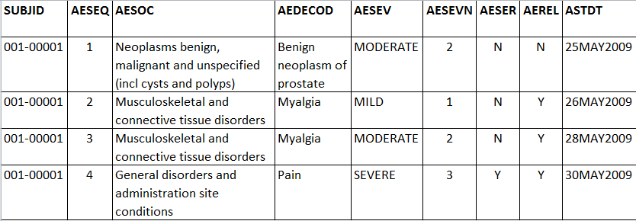
Exercise #1 Data

Slide 24
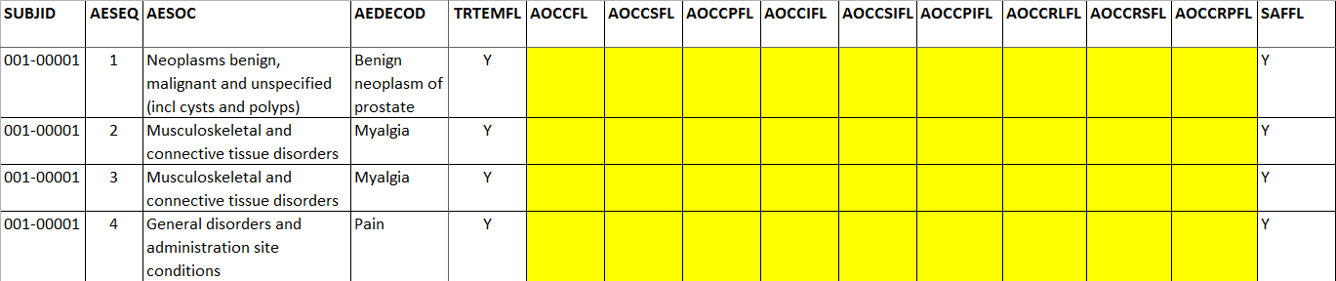
Exercise #1 Getting Started
Complete the Occurrence Flag Variables
See YELLOW highlighted cells
Use ADAE Standard and the Analysis Algorithm to set flags

Slide 25
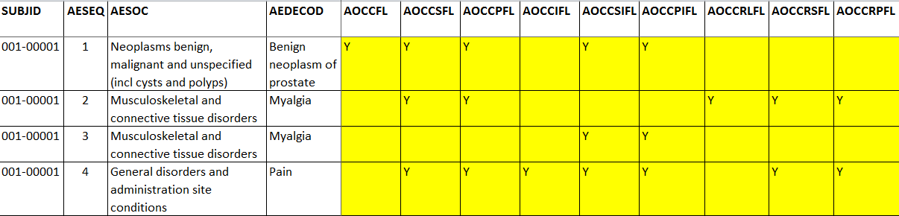
Exercise #1 Answer

Slide 26
Adverse Events of Interest

Slide 27
AE’s of Interest
The OCCDS for ADAE defines variables to indicate whether a given AEDECOD is of special importance
There are two methods for determining importance:
Structured MedDRA Query (SMQ): These are published by MedDRA
Customized Query (CQ): These are determined by the Sponsor
For both SMQ’s and CQ’s, there is a list of AEDECOD’s that fall within that query

Slide 28
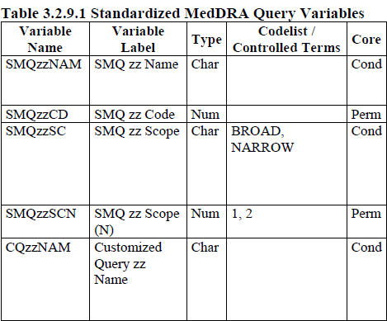
Use of Structured MedDRA Query
Standardized MedDRA Queries (SMQs) are becoming increasingly common in clinical trial safety evaluations
USUBJID | AEDECOD | SMQ01NAM
ABC123-01-00001 | Scleral haemorrhage | Haemorrhage terms (excl laboratory terms) (SMQ)
ABC123-01-00001 | Nausea
ABC123-01-00001 | Epistaxis | Haemorrhage terms (excl laboratory terms) (SMQ)

Slide 29
Lilly CORE_ADaM_ADAE – SMQzzNAM
Extract the SMQ's of interest within the scope set by the protocol and the desired version of the MedDRA dictionary used for the study into a dataset (Subsetted SMQ Dictionary dataset) Merge ADAE with the Subsetted SMQ Dictionary dataset by prefered term (ie., ADAE.AEDECOD = smq.pterm where smq refers to Subsetted SMQ Dictionary dataset) Set SMQ01NAM = smq for the appropriate matching preferred terms; Otherwise SMQ01NAM = "Null". Note: Each Standard MedDRA Query used in a study must use a separate SMQzzNAM.

Slide 30
Scope of SMQ’s
Some terms that fall into an SMQ represent very specific conditions of interest. These events are referred to as having a NARROW scope
The entire list of conditions that fall into an SMQ identifies all possible cases and therefore all events are referred to as being BROAD in scope
ADAE has ONE variable for scope – SMQxxSC with values of BROAD or NARROW
An analysis of all BROAD events includes those that are also NARROW
BROAD
NARROW

Slide 31

Customized Queries
OCCDS defines CQzzNAM which work the same way as SMQzzNAM variables
For customized queries, there is no concept of scope

Slide 32
SMQzzNAM and CQzzNAM
The variables SMQzzNAM and CQzzNAM work like flag variables for identifying records that need a given criteria
No additional *FL variables are needed (consider industry standards vs. Lilly’s current standards)
USUBJID | AEDECOD | SMQ01NAM | CQ01NAM
ABC01-101-00001 | Shortness of breathe | Anaphylactic reaction
ABC01-101-00001 | Nausea |  | Gastrointestinal disorders

Slide 33
Lilly Module 6 Exercise #2

Slide 34
Lilly Mod 6 Exercise #2
Open Lilly ADaM Mod 6 Exercise.xlsx
Open the following Lilly Standards:
Core_ADAM_ADAE_V8.xlsx
Core_ADAM_ADMH_V7.xlsx
Core_ADAM_ADCM_V9.xlsx
List all of the flag (*FL) variables used in ADAE, ADMH, and ADCM
Which flag variables are used in only one of the above Standards? Use in two? Use in all three?

Slide 35
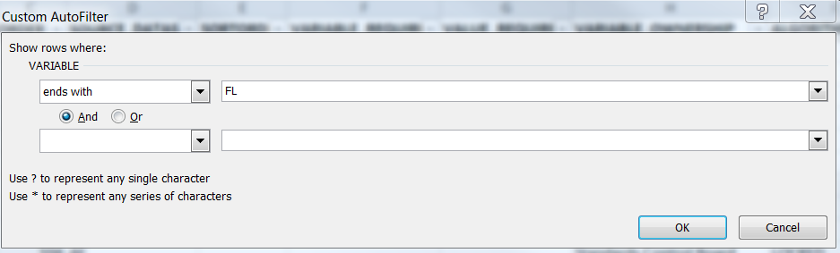
Exercise #2 Getting Started
First filter on the VARIABLE column and choose “Text Filter”
Scroll down to “ends with”
Type in “FL”

Slide 36
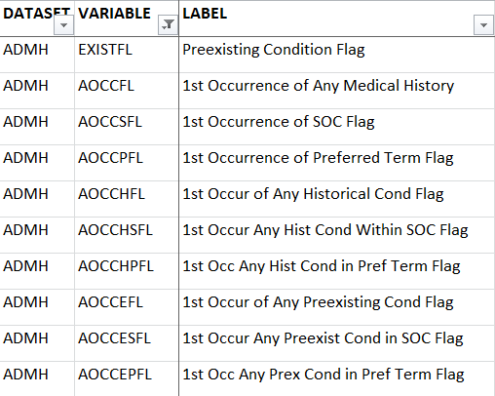
Exercise #2 Next Steps
Copy *FL variables into Worksheet for each Standard

Slide 37
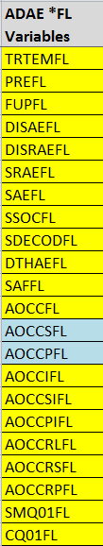


Exercise #2 Answer
There are only 2 flag variables in common between ADAE & ADMH: AOCCSFL and AOCCPFL
No flag variables are in common to AE, MH, & CM

Slide 38
ADaM OTHER

Slide 39

ADaM OTHER
What if we have an analysis need that:
Does NOT belong in ADSL?
Does NOT have one parameter for a row (BDS)?
Does NOT have one event for a row (OCCDS)?
Though rare, there are times NONE of the ADaM structures are the best fit for the analysis need
Notes:
RECAP: We have discussed ADaM standard structures of: ADSL BDS OCCDS

Slide 40
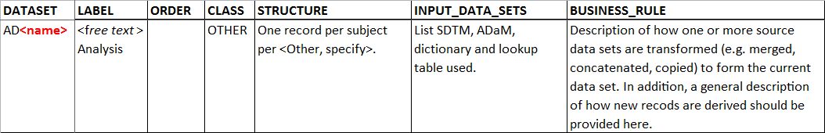

Lilly OTHER Table Metadata
ADaM OTHER is a class of ADaM data sets that:
Follows all of the ADaM basic principles
Uses standard ADaM variables and variable fragments
Does not use PARAM or AVAL
Is not based on occurrence data and counting of events
Notes:
It is to be used when no other ADaM structure will work
For OTHER, I believe that Lilly standard has them starting with AX, not AD (most likely will get a compliance error when running checks)

Slide 41
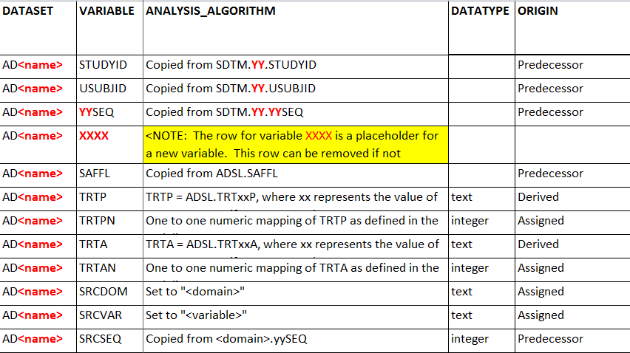
Lilly OTHER Column Metadata

Slide 42
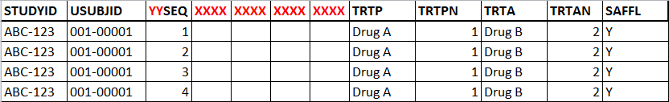
Uses for OTHER
Most likely, NOT used to support PRIMARY analyses (e.g., primary efficacy endpoints)
May be used as an Intermediate Data Set
e.g., EX + ADSL Variables + APERIOD
More info on Intermediate Data Sets coming up ☺
Should only be created after discussion with your ADaM SME
Notes:
It is to be used when no other ADaM structure will work

Slide 43
Example of an ADaM OTHER
Example: Add columns not allowed by BDS rules
Values from multiple parameters which were created in a BDS dataset to be on the same row so that exploratory analyses can be done
USUBJID | TTPINV | TTPADJ1 | TTPADJ2
ABC123-01-00001 | 126 | 95 | 117
Source metadata | AVAL where PARAMCD = TTPINV | AVAL where PARAMCD = TTPADJ1 | AVAL where PARAMCD = TTPADJ2

Slide 44
Intermediate Data Sets

Slide 45
Intermediate Data Sets
An Intermediate Data Set is used:
To assemble rows and columns that are sourced from one or more data sets (SDTM and/or ADaM)
As a first step towards the creation of a final analysis data set
SDTM Domain
Intermediate Data Set
ADaM Data Set

Slide 46
Intermediate Data Sets
Using an Intermediate Data Set may be the best way to:
Support traceability for complex derivations
Subset data, e.g., records used for analyses are a small subset of the records used for derivation
TTE
OS
PFS
ADEFF (Efficacy Responder Analysis)
ADTTE = Time-to-Event
ADOS = Overall Survival
ADPFS = Progression Free Survival

Slide 47

Use ADaM Principles
As with all ADaM data sets, intermediate data sets must follow the ADaM general principles
Intermediate data sets are seldom used to produce analyses
Intermediate data sets must be submitted as part of a submission since they contain important traceability and source records and variables

Slide 48
Module 6 Summary
The Occurrence Data Structure (OCCDS) is the 3rd type of ADaM Class with a defined Structure
OCCDS is used for event based data, such as analysis of AE, MH, CM, and CE
OCCDS uses a parent SDTM domain(s) and adds ADaM variables
e.g., flags, derived numeric variables, ADSL variables
ADaM OTHER is a recognized ADaM Class and may be useful for unique situations where BDS and OCCDS do not work
Intermediate data sets are a good way to enhance traceability
Notes:
AE = adverse events, MH = medical history, CM = concomitant medications, CE = clinical events

Slide 49
End of Module 6 ☺

